Slide 2
END HERE JUNE 3, 2020
WEEK 5
BEGIN HERE JUNE 10, 2020

Slide 3
Absence of Copyright
This slideshow contains photos, diagrams, and information, some of which were attained through internet searches of public websites. The author of this presentation does not own the copyright on this information, so this slideshow is for personal use only—not for sale or profit. Please utilize it to seek the Lord and grow in your knowledge of His Word and ways.

Slide 4
Prayer and Announcements
Contemplating the state of the world....
Notes:
Ate

Slide 5
END HERE JUNE 3, 2020
BEGIN HERE JUNE 10, 2020
RECORDING CUT OFF…
BEGIN HERE AGAIN JUNE 17, 2020

Slide 7
Prayer and Announcements
Sunday: 9:15 Fellowship
9:30 SS Master Class
10:30 Worship
Revelation Study available on our church website
www.faithprinceton.org
Email questions and comments to
pastor@faithprinceton.org

Slide 8
The Seven Churches of Revelation (cont.)

Slide 9
1:4
the seven churches that are in Asia:

Slide 10
Thyatira – Revelation 2:18-29
Notes:
Dispensational View: AD 606 – 1520 = Medieval Times, Middle Ages, Dark Ages
Historical View: a church following false teaching of sexual immorality and idolatry
Spiritual View: Be careful who you listen to … Repent

Slide 11
Thyatira – Revelation 2:18-29
¹⁸ “And to the angel of the church in Thyatira write:
The Son of God, who has eyes like a flame of fire, and His feet are like burnished bronze, says this:
¹⁹ ‘I know your deeds, and your love and faith and service and perseverance, and that your deeds of late are greater than at first. ²⁰ But I have this against you, that you tolerate the woman Jezebel, who calls herself a prophetess, and she teaches and leads My bond-servants astray so that they commit acts of immorality and eat things sacrificed to idols. ²¹ I gave her time to repent, and she does not want to repent of her immorality. ²² Behold, I will throw her on a bed of sickness, and those who commit adultery with her into great tribulation, unless they repent of her deeds.

Slide 12
Thyatira – Revelation 2:18-29
continued
²³ And I will kill her children with pestilence, and all the churches will know that I am He who searches the minds and hearts; and I will give to each one of you according to your deeds. ²⁴ But I say to you, the rest who are in Thyatira, who do not hold this teaching, who have not known the deep things of Satan, as they call them—I place no other burden on you. ²⁵ Nevertheless what you have, hold fast until I come. ²⁶ He who overcomes, and he who keeps My deeds until the end, to him I will give authority over the nations; ²⁷ and he shall rule them with a rod of iron, as the vessels of the potter are broken to pieces, as I also have received authority from My Father; ²⁸ and I will give him the morning star. ²⁹ He who has an ear, let him hear what the Spirit says to the churches.’

Slide 13
Thyatira – Revelation 2:18-29
Introduction/Description of Jesus
The Son of God, who has eyes like a flame of fire, and His feet are like burnished bronze
Symbolic of Truth/Justice/Judgment
Praise/Commendation
¹⁹ ‘I know your deeds, and your love and faith and service and perseverance, and that your deeds of late are greater than at first.
Showing progress (unlike Ephesus who was going backwards)
Sunday 5/31/20 sermon: 2 Peter 1:5-7 ⁵ Now for this very reason also, applying all diligence, in your faith supply moral excellence, and in your moral excellence, knowledge, ⁶ and in your knowledge, self-control, and in your self-control, perseverance, and in your perseverance, godliness, ⁷ and in your godliness, brotherly kindness, and in your brotherly kindness, love. ⁸ For if these qualities are yours and are increasing, they render you neither useless nor unfruitful in the true knowledge of our Lord Jesus Christ.

Slide 14
Thyatira – Revelation 2:18-29
Condemnation/Rebuke
²⁰ But I have this against you, that you tolerate the woman Jezebel, who calls herself a prophetess, and she teaches and leads My bond-servants astray so that they commit acts of immorality and eat things sacrificed to idols.
Jezebel, Wife of Ahab, King of Israel = 1 Kings 16-21; 2 Kings 9
1 Kings 21:25 Surely there was no one like Ahab who sold himself to do evil in the sight of the LORD, because Jezebel his wife incited him.
Notes:
Jezebel: Her “bed of love will become a bed of sickness” (Tyndale)
https://www.christianity.com/wiki/people/who-was-jezebel-in-the-bible-what-was-she-really-like.html
Who Was Jezebel in the Bible? What Was She Really Like?
Chad Napier
Crosswalk.com Contributing Writer
Queen Jezebel was the daughter of Ethbaal, king of Sidon, and the wife of Ahab, king of Israel. Jezebel promoted the worship of false gods in Israel, harassed and killed God’s prophets, and arranged for an innocent man to be falsely charged and executed.
King Ahab Marries Queen Jezebel
King Ahab, who “did more evil in the eyes of the LORD than any [king of Israel] before him,” (1 Kings 16:30) married Jezebel, making her the queen over Israel. We learn in 1 Kings 16:31, Jezebel was the daughter of Ethbaal, who was king of the Sidonians (or Phoenicians).
Before becoming king, Ethbaal was noted to have been a priest of Astarte, which was the Greek form of the moon goddess Ashtoreth. Astarte is what the Phoenicians called her. According to Easton’s Bible Dictionary, Ashtoreth was “frequently associated with the name of Baal, the sun-god, [the Phoenicians’] chief male deity.”
Jezebel’s father Ethbaal was politically connected to King Ahab in Israel, which could explain the marriage between the two. This influence led to the promotion of false gods among the people of Israel.
As detailed in 1 Kings 16:31-32, Jezebel persuaded her husband to promote the worship of deities, Baal and Asherah, among the people of Israel. It was common during this era of kingdoms for the king to establish worship facilities for foreign wives. In this case, Jezebel required the installation of a temple and an altar for Baal, which was built in Samaria. Since she was Phoenician, Jezebel more than likely had a role that was more active than what was normal in Hebrew rule.
During Ahab’s reign in Israel, the people were deeply divided as to either worship and serve Baal or the Lord. Animosities were so heighted that Jezebel ordered the death of the Lord’s prophets, while she fully supported the prophets of Baal and Asherah.
Obadiah was a governor in the region who greatly feared the Lord. He protected 100 of the Lord’s prophets, hiding them in caves and feeding them (1 Kings 18:3-4).
Elijah and Ahab
A confrontation ensued between Elijah and King Ahab, which resulted in a gathering of all the prophets at Mount Caramel. At the gathering Elijah proclaimed himself to be the only remaining prophet of the Lord, following the execution of the others. The prophets of Baal numbered 450.
Elijah requested two bulls, one for himself and one for the Baal prophets. The bulls were to be cut into pieces and laid on wood as an alter without the usage of fire. Elijah requested the prophets to call upon Baal to provide the fire, and he would call upon the Lord to provide.
The prophets of Baal called upon their god for hours without any type of response. This silence distressed them. “So they shouted louder and slashed themselves with swords and spears, as was their custom, until their blood flowed” (1 Kings 18:28).
When it was Elijah’s turn, he cut up the bull and laid it upon the wood without any assistance of fire. Then he added 12 stones to the altar to represent the number of the tribes of the sons of Jacob and dug a deep trench around the alter. He then called for the crowd to pour four barrels of water onto the sacrifice and wood. He instructed this be done at least three times, causing water to surround the altar and fill the trench.
Elijah summoned the Lord and petitioned, “LORD, the God of Abraham, Isaac and Israel, let it be known today that you are God in Israel and that I am your servant and have done all these things at your command. Answer me, LORD, answer me, so these people will know that you, LORD, are God, and that you are turning their hearts back again” (1 Kings 18:36-37).
Immediately, “the fire of the Lord fell and consumed the burnt sacrifice, and the wood, and the stones, and the dust, and licked up the water that was in the trench” (1 Kings 18:38). When the people witnessed the validity of the Lord, they fell on their faces and proclaimed, “he is the God: the Lord, he is the God” (1 Kings 18:39). Elijah then ordered the killing of all Baal prophets.
Knowing Queen Jezebel’s rage and imminent desire for vengeance, Elijah fled to the wilderness under a juniper tree.
Naboth and Jezebel
In 1 Kings 21, we see how Jezebel organized the death of Naboth.
Naboth owned a vineyard near the palace of King Ahab. Ahab demanded Naboth give him the vineyard for the purpose of an herb garden. He offered to improve the profitability of the vineyard from its current state or pay him for the vineyard. Naboth denied this request because “[t]he Lord forbid that I should give you the inheritance of my ancestors” (1 Kings 21:3). Ahab was “sullen and angry” (1 Kings 21:4) with the rejection, but Queen Jezebel concocted a scheme to get the vineyard.
She forged letters under Ahab’s name and seal requesting a fast. Additionally, the letters ordered Naboth be charged with blasphemy against God, which would be supported by the false testimony of two scoundrels. The orders further demanded that Naboth be stoned to death. Jezebel’s plan was successfully carried out exactly as planned and Naboth was executed.
As soon as Ahab got word of Naboth’s death, he went to take possession of the vineyard. As the Lord instructed the prophet, Elijah came out of the wilderness to meet Ahab at the vineyard and confronted him about Jezebel’s conspiracy against Naboth as well as Ahab’s sinful actions that were causing Israel to sin.
For Jezebel’s guilt in the matter, the Lord proclaimed, “[t]he dogs shall eat Jezebel by the wall of Jezreel” (1 Kings 21:23). The Lord casted much of the blame to Jezebel by explaining, “[t]here was never anyone like Ahab, who sold himself to do evil in the eyes of the LORD, urged on by Jezebel his wife” (1 Kings 21:25).
When Ahab “heard these words,” he realized his guilt in the conspiracy and “rent his clothes, and put sackcloth upon his flesh, and fasted, and lay in sackcloth, and went around meekly” (1 Kings 21:27).
In His great mercy, the Lord came to Elijah and said He would not bring evil upon Ahab in his life because he humbled himself, but judgment would pass onto his son’s days. Ahab lived another three years before died in the ensuing battle between Syria and Israel. His son Ahaziah took over the throne but died soon thereafter and was succeeded by Joram.
How did Jezebel die?
The prophet Elisha, successor to Elijah, sent orders to Jehu, a commander in Joram’s army, to eliminate all of Ahab’s descendants.
Jehu killed Joram, then proceeded to Jezreel, where Queen Jezebel was, as she was his next obstacle for his promotion to king. In 2 Kings 9:30, we learn “When Jezebel heard about it, she put on eye makeup, arranged her hair and looked out of a window.”
The adornments were not to entice Jehu, but to reflect her majesty, pride, and haughty spirit. Jehu looked up to the window and asked, “[w]ho is on my side? Who? And there looked out to him two or three eunuchs. ‘Throw her down!’ Jehu said.” (2 Kings 9:32-33). Then the eunuchs threw Jezebel out of the window.
The eunuchs were used as servants to women of royalty. Jezebel was likely a very cruel to them and therefore did not earn any favor among them.
Ironically, the pride, selfishness, and greed of Jezebel ultimately led to her demise and death. She used her attraction and affection to gain a place in the government and was able to use her influence to spread the worship of Baal among the people of Israel. However, her pride and spirit to enact vengeance led to her death when the judgment of her family was brought to fruition, as promised by the Lord.

Slide 15
Thyatira – Revelation 2:18-29
Condemnation/Rebuke
²⁰ But I have this against you, that you tolerate the woman Jezebel, who calls herself a prophetess, and she teaches and leads My bond-servants astray so that they commit acts of immorality and eat things sacrificed to idols.
Special Consequences
²¹ I gave her time to repent, and she does not want to repent of her immorality. ²² Behold, I will throw her on a bed of sickness, and those who commit adultery with her into great tribulation, unless they repent of her deeds. ²³ And I will kill her children with pestilence, and all the churches will know that I am He who searches the minds and hearts; and I will give to each one of you according to your deeds.
Notes:
Jezebel: Her “bed of love will become a bed of sickness” (Tyndale)
Time to repent!
All the churches will know that I am He!!!

Slide 16
Thyatira – Revelation 2:18-29
Condemnation/Rebuke
I will give to each one of you according to your deeds. ²⁴ But I say to you, the rest who are in Thyatira, who do not hold this teaching, who have not known the deep things of Satan, as they call them—I place no other burden on you.
According to your deeds = Psalm 62:12; Prov. 11:31; 24:12; Romans 2:6; 1 Cor. 3:8; 4:5; 2 Cor. 5:10; Colossians 3:25; 1 Peter 1:17
Revelation 20:12 And I saw the dead, the great and the small, standing before the throne, and books were opened; and another book was opened, which is the book of life; and the dead were judged from the things which were written in the books, according to their deeds.
I place no other burden on you
Notes:
The church is judged by what it does, what it allows, how it remains true to the Lord, etc.
But individuals within the church are known and judged based on their own loyalty and faithfulness to the Lord.
Judgment according to deeds:
Psalm 62:12
And lovingkindness is Yours, O Lord, For You recompense a man according to his work.
Proverbs 11:31
If the righteous will be rewarded in the earth, How much more the wicked and the sinner!
Proverbs 24:12
If you say, “See, we did not know this,” Does He not consider it who weighs the hearts? And does He not know it who keeps your soul? And will He not render to man according to his work?
Romans 2:6
who will render to each person according to his deeds:
1 Corinthians 3:8
Now he who plants and he who waters are one; but each will receive his own reward according to his own labor.
1 Corinthians 4:5
Therefore do not go on passing judgment before the time, but wait until the Lord comes who will both bring to light the things hidden in the darkness and disclose the motives of men’s hearts; and then each man’s praise will come to him from God.
2 Corinthians 5:10
For we must all appear before the judgment seat of Christ, so that each one may be recompensed for his deeds in the body, according to what he has done, whether good or bad.
Colossians 3:25
For he who does wrong will receive the consequences of the wrong which he has done, and that without partiality.
1 Peter 1:17
If you address as Father the One who impartially judges according to each one’s work, conduct yourselves in fear during the time of your stay on earth;
Revelation 20:12
And I saw the dead, the great and the small, standing before the throne, and books were opened; and another book was opened, which is the book of life; and the dead were judged from the things which were written in the books, according to their deeds.

Slide 17
Thyatira – Revelation 2:18-29
Condemnation/Rebuke
I will give to each one of you according to your deeds. ²⁴ But I say to you, the rest who are in Thyatira, who do not hold this teaching, who have not known the deep things of Satan, as they call them—I place no other burden on you.
Charge/Challenge
²⁵ Nevertheless what you have, hold fast until I come.
Hold fast =
Notes:
The church is judged by what it does, what it allows, how it remains true to the Lord, etc.
But individuals within the church are known and judged based on their own loyalty and faithfulness to the Lord.

Slide 18
Thyatira – Revelation 2:18-29
Consequences
I will give to each one of you according to your deeds. ²⁴ But I say to you, the rest who are in Thyatira, who do not hold this teaching, who have not known the deep things of Satan, as they call them—I place no other burden on you.
Deep things of Satan = early gnosticism?
Notes:
Vs. 24
“Deep things of Satan”???
Lion and the Lamb Newport, 153
This reference is frequently interpreted as an attack upon an incipient Gnosticism. The “gnostics” were those who believed that God had given to them some special knowledge which automatically mae them children of God.
Johnson suggests that the reasoning of some in the early church (the Nicolaitans) may have suggested that the only effective way to be learned only by experience. In fact, only those who have really experienced sin can truly appreciate grace. Thus by experiencing the depths of paganism (the deep secrets of Satan”), one would be better equipped to serve Christ or to be an example of freedom to his brothers (compare 1 Cor. 8:9-11). If this is true, the sin of Jezebel is deadly serious because of the depths of its deception. Only a few perceive where the teaching is leading (v. 24).
Romans 6:1-2 What shall we say then? Are we to continue in sin so that grace may increase? May it never be! How shall we who died to sin still live in it?

Slide 19
Thyatira – Revelation 2:18-29
Consequences
I will give to each one of you according to your deeds. ²⁴ But I say to you, the rest who are in Thyatira, who do not hold this teaching, who have not known the deep things of Satan, as they call them—I place no other burden on you.
Promise
²⁶ He who overcomes, and he who keeps My deeds until the end, to him I will give authority over the nations; ²⁷ and he shall rule them with a rod of iron, as the vessels of the potter are broken to pieces, as I also have received authority from My Father; ²⁸ and I will give him the morning star.
“AUTHORITY OVER NATIONS” – Psalm 2:8-9; 1 Cor. 6:1-6
Notes:
Vs. 26-27
Tyndale
The reward for the overcomer is authority over the nations (cf. Ps. 2:8–9), a dazzling prospect but one that demanded great faith from a tiny church. With it is linked He will rule them with an iron sceptre (presumably a staff tipped with iron). The verb rendered rule literally means ‘shepherd’. We usually think of the shepherd in terms of kindness and tender care. But the shepherd was an autocrat. His power over his flock was absolute, and it is this aspect of the shepherd’s life that is in view. Shepherding with an iron rod might denote no more than strength or firmness were it not linked with breaking to pieces like clay vessels (cf. Ps. 2:9; Jer. 51:20). Further, it is likened to the gift the Father gave the Son. This seems to show that the overcomer will have a place in the final decisive victory of Christ over the world forces opposed to God.
Psa. 2:8 Ask of me, and I will make the nations your heritage,
and the ends of the earth your possession.
9 You shall break them with a rod of iron and dash them in pieces like a potter’s vessel.”
1 Corinthians 6:1-6
Does any one of you, when he has a case against his neighbor, dare to go to law before the unrighteous and not before the saints? Or do you not know that the saints will judge the world? If the world is judged by you, are you not competent to constitute the smallest law courts? Do you not know that we will judge angels? How much more matters of this life? So if you have law courts dealing with matters of this life, do you appoint them as judges who are of no account in the church? I say this to your shame. Is it so, that there is not among you one wise man who will be able to decide between his brethren, but brother goes to law with brother, and that before unbelievers?
1 Corinthians 6:1‭-‬6 NASB
https://bible.com/bible/100/1co.6.1-6.NASB

Slide 20
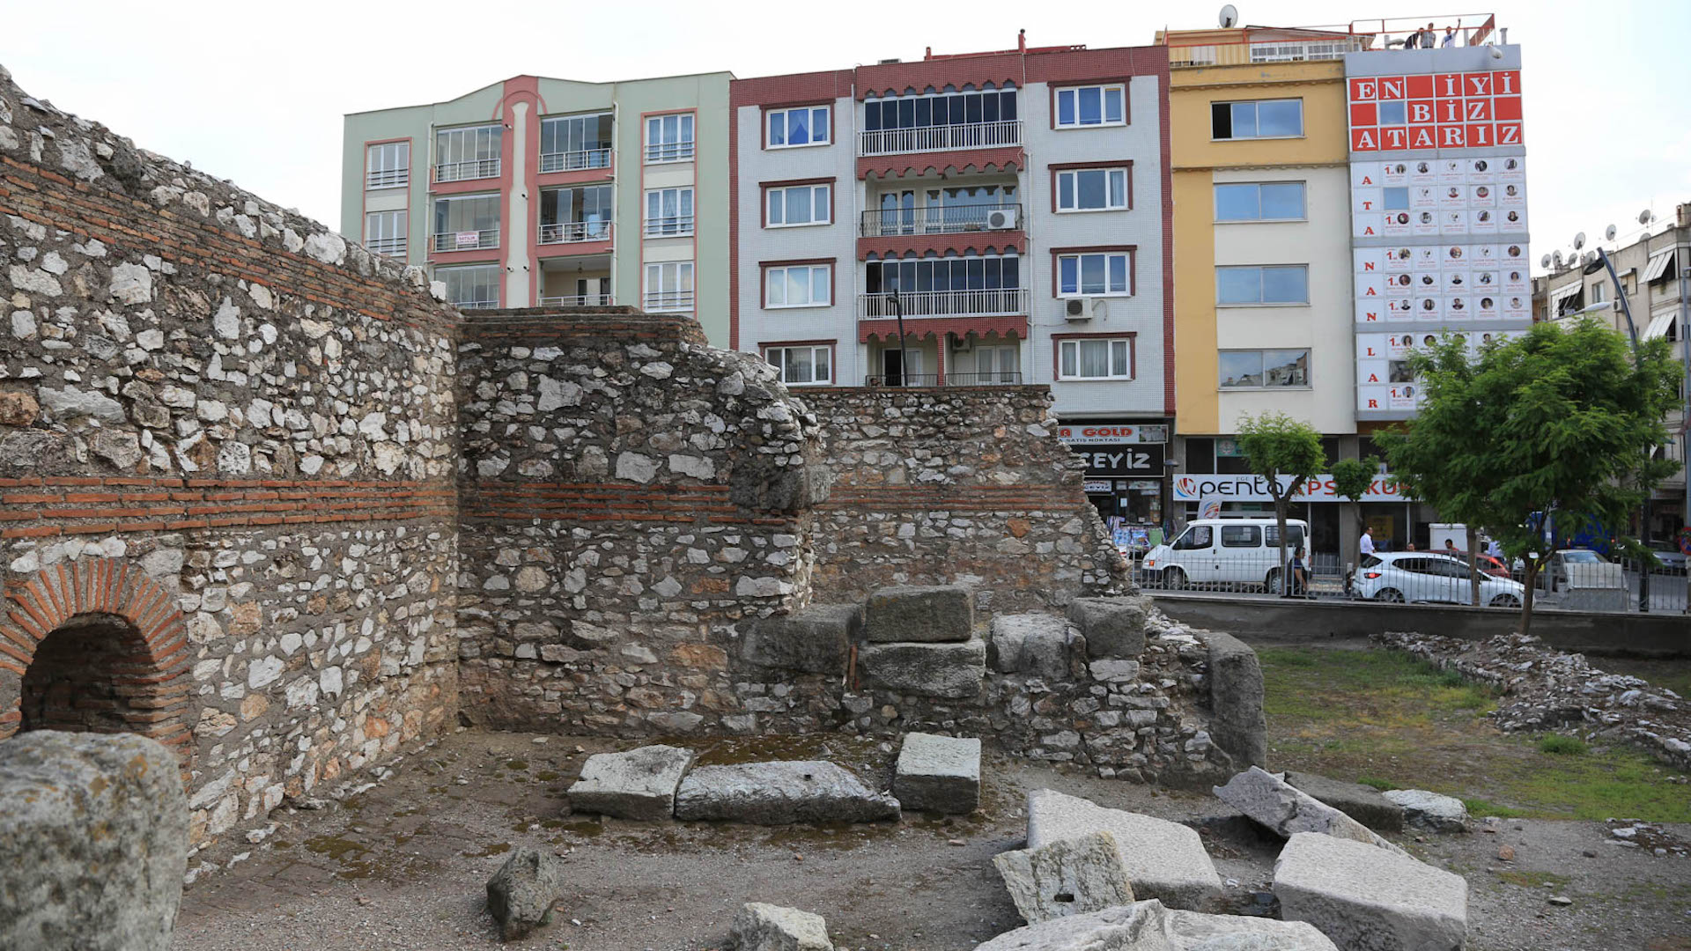
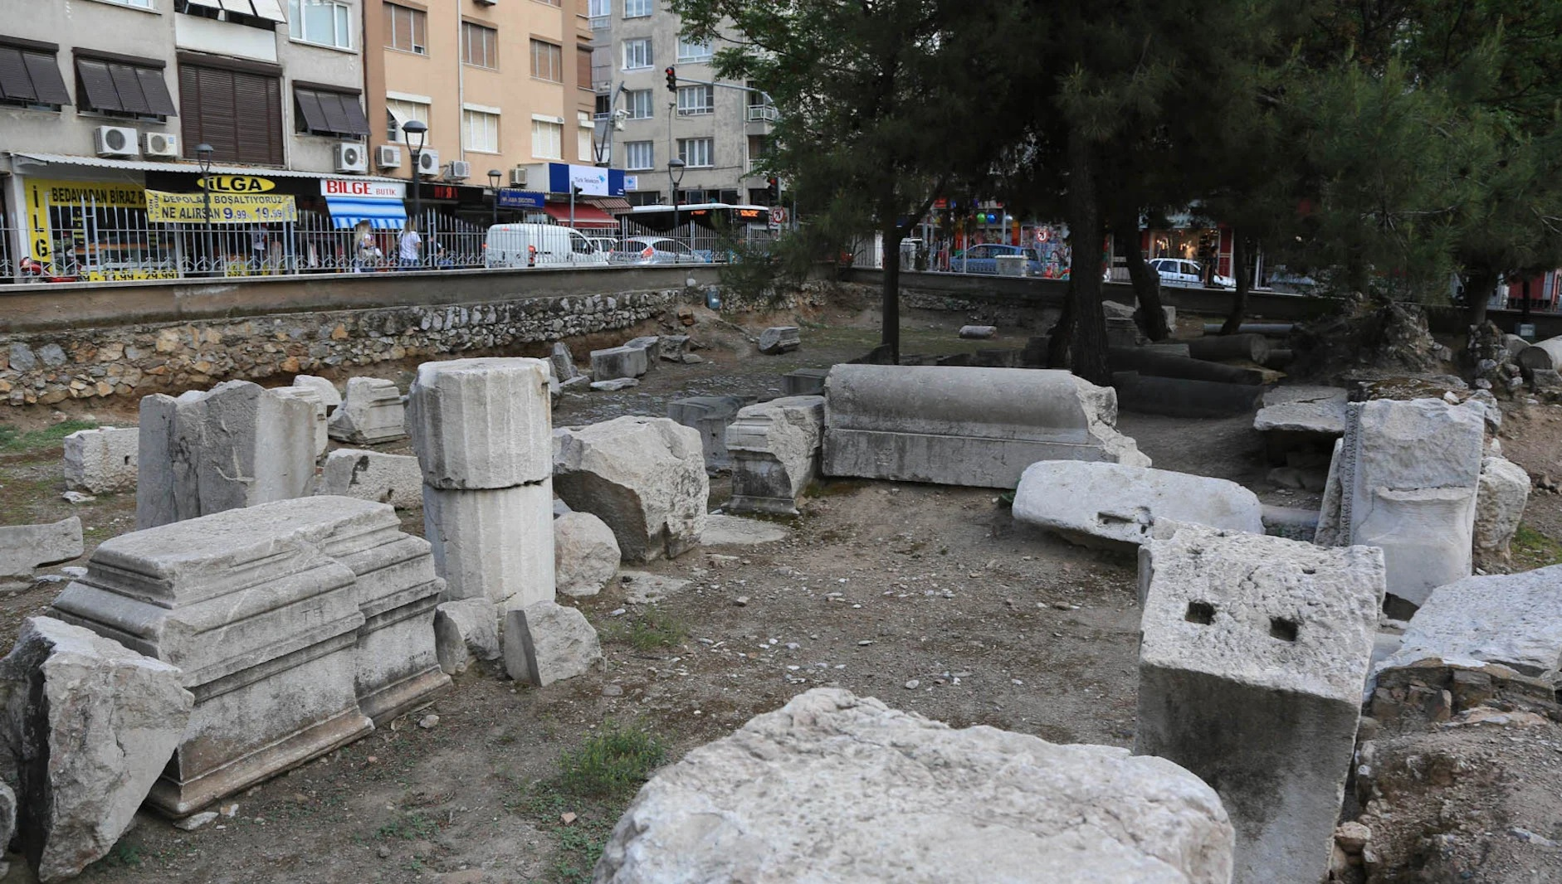
Thyatira – Revelation 2:18-29
Ruins from an unknown ancient structure remain fenced-off from modern-day life in Akhisar. Photo by Karrie Sparrow.
An apartment building overlooks the crumbled walls of ancient Thyatira. It’s possible Paul and Silas visited Thyatira during their second or third missionary journey. Photo by Karrie Sparrow.
Notes:
https://www.imb.org/2018/06/01/what-happened-to-the-seven-churches-of-revelation/
What Happened to the Seven Churches of Revelation?
By Madeline Arthington and Karrie Sparrow
Thyatira-Akhisar
In the book of Acts, Lydia was a wealthy benefactress and convert to Christianity. A seller of purple cloth, Lydia’s original home was the city of Thyatira. The ancient coins of Thyatira show a multitude of guilds including linen weavers, bronze workers, potters, and bakers. Thyatira was the only city of the Seven Churches built on flat ground without natural defenses, making it vulnerable to attack. In John’s vision, Jesus is described with feet like burnished bronze—a metaphor Thyatira citizens would have easily grasped because of its bronze workers.
Jesus warned those in Thyatira who were tolerating the deceptive teaching of “Jezebel,” an unrepentant influencer or perhaps a symbol for the licentiousness that led people into Satan’s “deep secrets” (Rev. 2:20, 24 NIV). Few in Thyatira had remained true to the faith, and Jesus encouraged them to “hold on” (Rev. 2:25 NIV). He promised authority over nations to those who persevere until the end.
The scant ruins of Thyatira are unearthed in the modern city of Akhisar. Contemporary apartment buildings line streets teeming with busses and cars. There is no church in Akhisar and no known believers.
Today, more than one hundred thousand people live in Akhisar. The city is well known for its olive and textile industries. Photo by Karrie Sparrow.

Slide 21
Thyatira – Revelation 2:18-29
Message
Be careful who you listen to.
Repent.
Hold fast to the Truth.

Slide 22
Sardis – Revelation 3:1-6
Notes:
Dispensational View: Protestant Reformation AD 1520 – 1750 (and continuing into the Tribulation)
Historical View: a church with a reputation for activity but incomplete works
Spiritual View: You can look alive but still be dying on the inside.

Slide 23
Sardis – Revelation 3:1-6
¹ “To the angel of the church in Sardis write:
He who has the seven Spirits of God and the seven stars, says this: ‘I know your deeds, that you have a name that you are alive, but you are dead. ² Wake up, and strengthen the things that remain, which were about to die; for I have not found your deeds completed in the sight of My God. ³ So remember what you have received and heard; and keep it, and repent. Therefore if you do not wake up, I will come like a thief, and you will not know at what hour I will come to you. ⁴ But you have a few people in Sardis who have not soiled their garments; and they will walk with Me in white, for they are worthy. ⁵ He who overcomes will thus be clothed in white garments; and I will not erase his name from the book of life, and I will confess his name before My Father and before His angels. ⁶ He who has an ear, let him hear what the Spirit says to the churches.’

Slide 24
Sardis – Revelation 3:1-6
Introduction/Description of Jesus
He who has the seven Spirits of God and the seven stars
Praise/Commendation
None
⁴ But you have a few people in Sardis who have not soiled their garments

Slide 25
Sardis – Revelation 3:1-6
Condemnation/Rebuke
‘I know your deeds, that you have a name that you are alive, but you are dead. ² Wake up, and strengthen the things that remain, which were about to die; for I have not found your deeds completed in the sight of My God.
Name = reputation!
Charge/Challenge
³ So remember what you have received and heard; and keep it, and repent.
Similar to Ephesus (Remember, Repent, and Do the first things)
Here: Remember, Keep, and Repent.
Keep = τήρει (from tēros, "a guard") – properly, maintain (preserve); (figuratively) spiritually guard (watch), keep intact.
Notes:
Tyndale
Unless an ember is fanned into flames it is lost. This church may have pleased men but it did not please God. Nothing it did was complete in the sight of my God; its works were not brought to fulfilment.
“Remember” and “Keep” (obey) are present tense implying continuous action.
“Repent” is aorist implying urgent necessity!

Slide 26
Sardis – Revelation 3:1-6
Consequences
Therefore if you do not wake up, I will come like a thief, and you will not know at what hour I will come to you
Promise
⁴ But you have a few people in Sardis who have not soiled their garments; and they will walk with Me in white, for they are worthy. ⁵ He who overcomes will thus be clothed in white garments; and I will not erase his name from the book of life, and I will confess his name before My Father and before His angels.
White = blameless, righteous, innocent
The book of life = Revelation 20:11-15 ➔
Notes:
Tyndale
If the church does not watch, Christ will come to it like a thief. This proverbial expression for unexpectedness (Matt. 24:43; 1 Thess. 5:2; 2 Pet. 3:10) is further emphasized with you will not know at what time I will come to you. This is not a reference to the second coming, which will take place whether the Sardians are watchful or not. But Christ comes in many ways and this is clearly a limited coming in judgment on unrepentant sinners. Their fate is none the less fearsome because left undefined
Jesus said he would confess before the angels anyone who confesses him (Luke 12:8–9; he will also deny one who denies him).
Revelation 20:11-15
The Final Judgment
11And I saw a great white throne and the one sitting on it. The earth and sky fled from his presence, but they found no place to hide. 12I saw the dead, both great and small, standing before God’s throne. And the books were opened, including the Book of Life. And the dead were judged according to what they had done, as recorded in the books. 13The sea gave up its dead, and death and the grave gave up their dead. And all were judged according to their deeds. 14Then death and the grave were thrown into the lake of fire. This lake of fire is the second death. 15And anyone whose name was not found recorded in the Book of Life was thrown into the lake of fire.

Slide 27
Revelation 20:11-15
The Final Judgment and the Book of Life
11 And I saw a great white throne and the one sitting on it. The earth and sky fled from his presence, but they found no place to hide. 12 I saw the dead, both great and small, standing before God’s throne. And the books were opened, including the Book of Life. And the dead were judged according to what they had done, as recorded in the books. 13 The sea gave up its dead, and death and the grave gave up their dead. And all were judged according to their deeds. 14 Then death and the grave were thrown into the lake of fire. This lake of fire is the second death. 15 And anyone whose name was not found recorded in the Book of Life was thrown into the lake of fire.

Slide 28
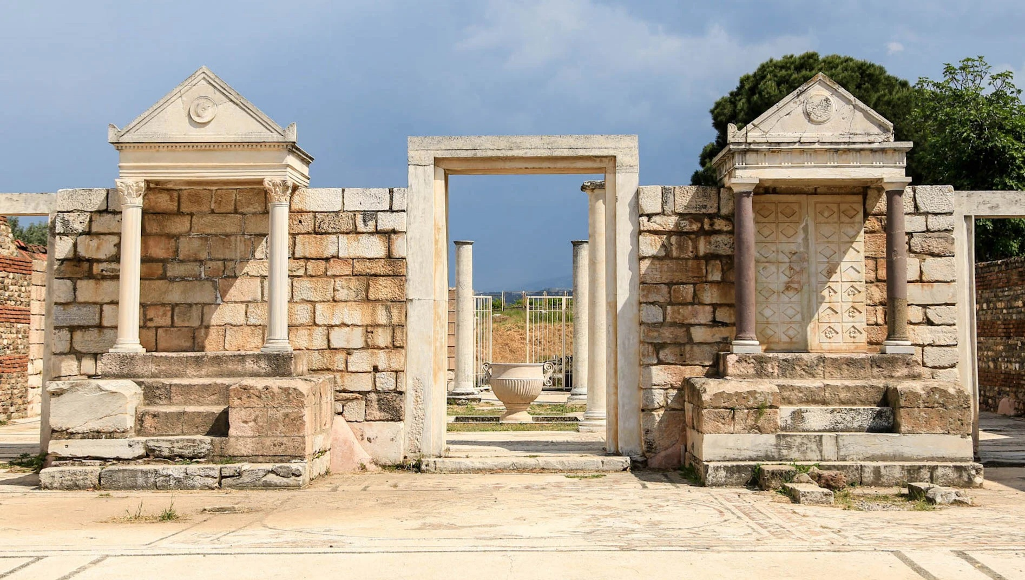
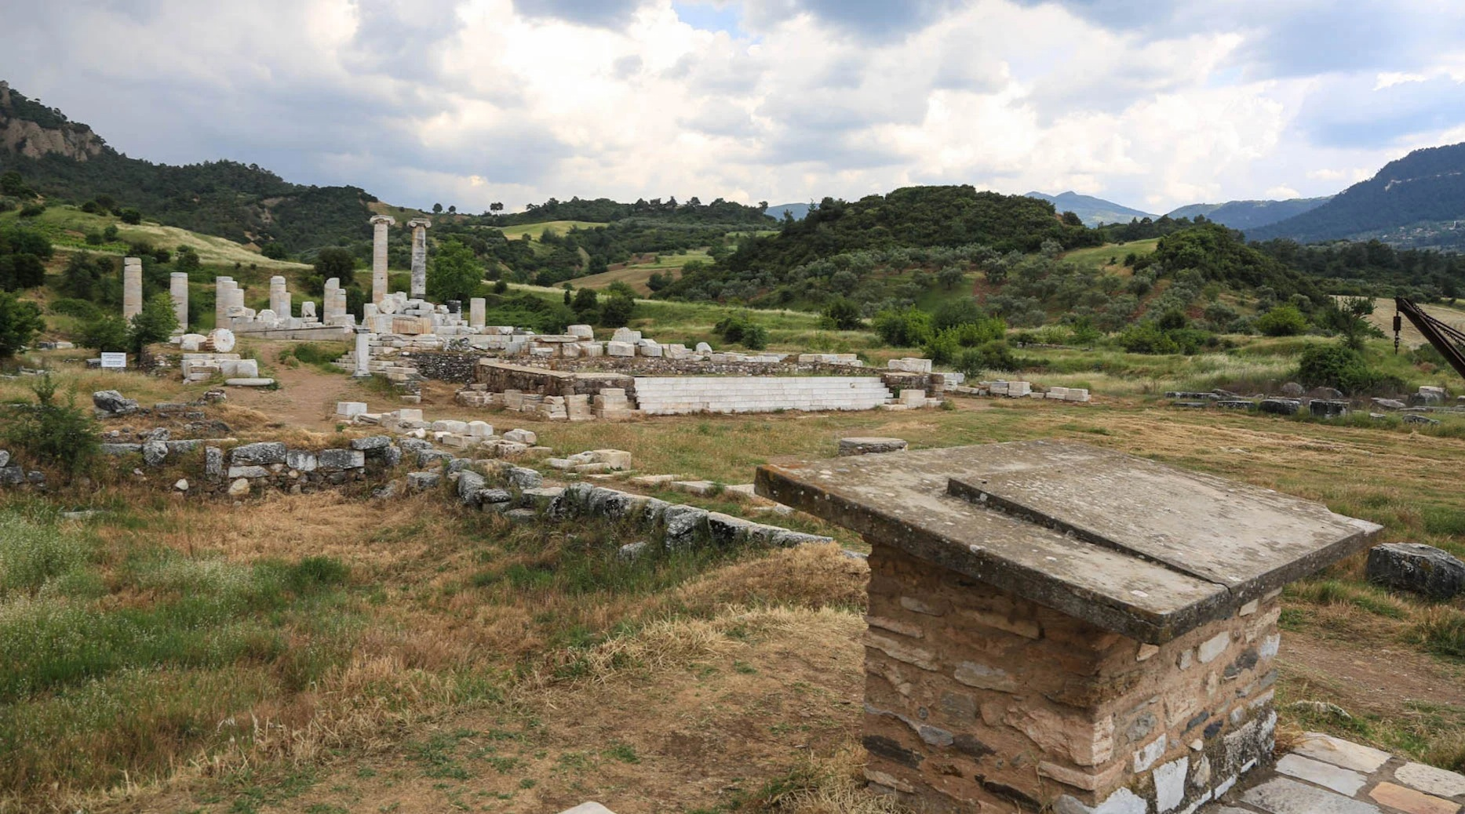
Sardis – Revelation 3:1-6
Construction and use of the Temple of Artemis in Sardis began during the time of Alexander the Great, near fourth century BC. The temple was still unfinished by the fourth century AD and was all but abandoned when Christianity entered Sardis.
Photo by Karrie Sparrow.
The Jewish synagogue in Sart was in use for up to six hundred years. Many believe it serves as proof that Judaism remained strong even as Christianity was introduced in the region. Photo by Karrie Sparrow.
Notes:
https://www.imb.org/2018/06/01/what-happened-to-the-seven-churches-of-revelation/
What Happened to the Seven Churches of Revelation?
By Madeline Arthington and Karrie Sparrow
Sardis-Sart
We parked our car—the only vehicle in the gravel lot at the ruins of Sardis—and climbed out to view the extensive excavations. The legendary, wealthy King Croesus, who amassed gold from a nearby river, reigned from Sardis in the 500s BC. Ruins from an Artemis temple—originally dating from the fifth century BC and rebuilt by Alexander the Great one hundred years later—still stand today. A stadium, shops, and ruins of the largest ancient Jewish synagogue in the world were a short jaunt from the temple. At the time of John’s vision in Revelation, Sardis was one of the wealthiest Roman cities despite having been rebuilt multiple times after devastating earthquakes.
Jesus’s words in Revelation sliced through Sardis’s thriving “health” to the church’s spiritual realities. Although there were a faithful few, most people in the Sardis church were spiritually dead and dying. Christ summoned them to “wake up,” “remember,” and “repent” (Rev. 3:2–3 NIV). Ruins from a small, fourth-century Byzantine church stand on the grounds of the Temple of Artemis. I found the crumbling church—built a few hundred years after John’s letter—to be a hopeful sign that some in Sardis took the warning to repent.
The modern town of Sart—only a mile from the ruins—has just over five thousand inhabitants. A nearby village, adjacent to the ruins, carries on with rural life. Children run in the dusty streets. Farmers drive tractors into the surrounding fields. There are no known Christians in Sart today.

Slide 29
Sardis – Revelation 3:1-6
Message
A good reputation means nothing without inner Spiritual life
We need to wake up and work for the Lord’s Kingdom until He comes
Your spiritual life is not judged by the activities or spirituality of those around you
Notes:
We need to lay down our “rights” and pick up “the Kingdom.”

Slide 30
END HERE JUNE 17, 2020
BEGIN HERE JUNE 24, 2020

